Slide 1
Night

Slide 2
Brent McFadyen

Slide 3
Sponge Bob and Friend
ISO 2800, 10mm, f/3.5, 1/60sec

Slide 4
Fountain Bellagio
ISO 1000, 10mm, f/3.5, 1/15sec.--Stabilized using flat railing

Slide 5
Thanksgiving in VEGAS
ISO 3200, 16.3 mm, f/4.2, 1/100th sec

Slide 6
Las Vegas Street Scene
ISO 450, 10mm, f/3.5, 1/30 With a Nikon 1

Slide 7
VEGAS
SO 3200, 19.6 mm, f/4.8, 1/60, with flash

Slide 8
Lindsay Sullivan

Slide 9
Calgary Bridge
ISO 400, f/11, 8 sec, 19 mm (18-55 mm lens), Sony NEX-5N

Slide 10
Calgary Part 1
ISO 100, f/16, 15 sec, 149 mm (18-200 mm lens), WB daylight, Sony NEX-5N

Slide 11
Calgary Part 2
ISO 100, f/16, 15 sec, 149 mm (18-200 mm lens), WB tungsten, Sony NEX-5N

Slide 12
Fireworks 1
ISO 400, f/22, 6 sec, 18 mm (18-200 mm lens), Sony NEX-5N

Slide 13
Fireworks 2
ISO 200, f/11, 1/4 sec, 18 mm (18-200 mm lens),
Sony NEX-5N

Slide 14
Peter Hopkins

Slide 15
Bldg 20_1
Canon 24-70 mm, F13, ISO400, 30 sec, 40 mm, Aperture Priority

Slide 16
Icicles_2
Canon 24-70 mm, F4, ISO 640, 5 sec, 63 mm, Aperture Priority

Slide 17
Ship's Prow-Canmore Wall
Canon 24-70 mm, F8, ISO 200, 146 sec, 55 mm, Bulb Exposure

Slide 18
SMH_1
Canon 24-70 mm, F8, ISO 200, 15 sec, 28 mm, Aperture Priority

Slide 19
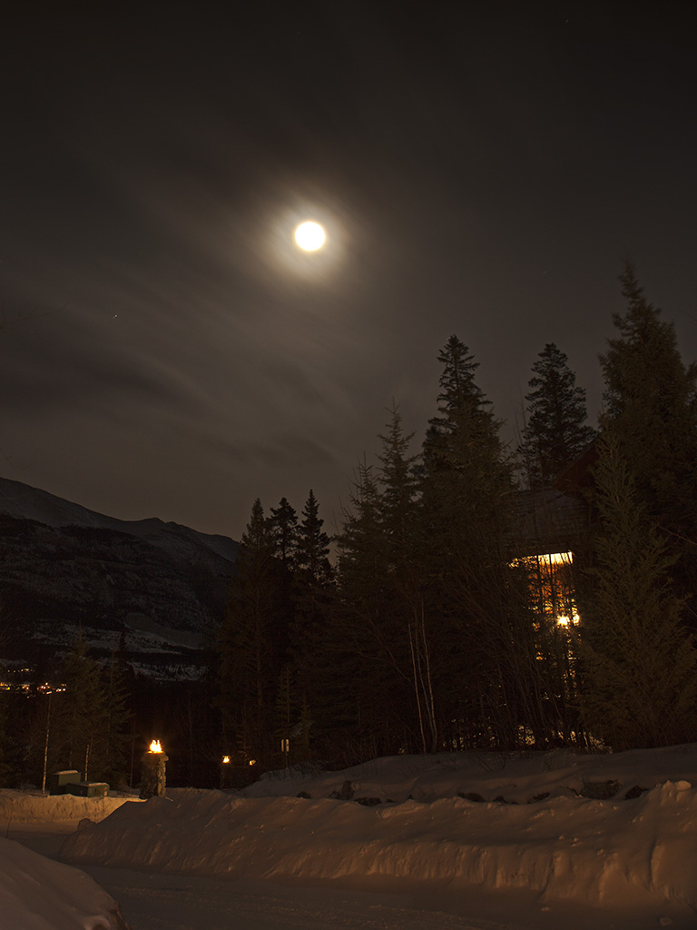
Winter Moon_2
Canon 24-70 mm, F8, ISO 200, 68 sec,
24 mm, Bulb Exposure

Slide 20
Harv Emter

Slide 21
Night
3 sec. Double exposure, 50mm @ f8,
ISO -100, No Flash

Slide 22
Night 1
30 sec, 40mm @ f11, ISO -100, No Flash

Slide 23
Night 2
25sec, 26 mm @ f8, ISO -800, Flashlight

Slide 24
Night 3
25sec, 30mm @ f8, ISO -400, Off Camera--popped several places

Slide 25
Night 4
1/40 sec, 185mm @ f5, ISO -400, No Flash

Slide 26
Joseph Potts

Slide 27
Front Yard
Canon 7D, 6 sec, f/8, ISO 400, 17-55 mm lens, 38 mm

Slide 28
Las Vegas Hotels
Canon 7D, 2 sec, f/8, ISO 100, 17-55 mm lens, 20 mm

Slide 29
Granville Island
Canon 5D-3, 1/15 sec, f/4, ISO 1250, 24-105mm lens, 47 mm

Slide 30
Canmore July 1
Canon 5D-3, 5sec, f/4, ISO 160,
17-40 lens, 17 mm

Slide 31
Coke—supersize me
Canon 7D, 5 sec, f/8, ISO 100,
17-55 mm lens, 17 mm

