Slide 1
Sports Action
Peter Hopkins

Slide 2
Key to Sports Action Photos is Shutter Speed
Blur to convey sense of motion
Track the subject, blur the background
Blur the subject, freeze the background
Slow shutter speeds: 1/20-1/30 sec
Varies with the speed of the subject
“Freeze” the action
As fast as the available light will allow, 1/500 sec +

Slide 3
Camera Settings
AF-Servo (Canon); AF-Continuous (Nikon)
All focal points active
Focus distance range 2.5m-infinity for faster focus
Image stabilizer, mode 2
Aperture vs Shutter priority
Continuous shutter
Focal length to allow ample frame

Slide 4
Blur Conveys Sense of Motion Blur the Subject
Canon EF 100-400 mm, f4.5-5.6
Focal length 285 mm
Approximately 100 m from subject
Lock on background, let skier move into the frame
Lens fixed relative to background
Subject in motion relative to the lens
Challenge is to find shutter speed for the speed of the subject
Blurred subject, background sharp
F29.0, 1/20 sec, ISO 100

Slide 5
Blur Conveys Sense of Motion Track the Subject
Canon EF 100-400 mm, f4.5-5.6
Focal length 100 mm
Approximately 40 m from subject
Lock on, track car
Lens moves relative to background
No lens motion relative to subject
Challenge is to find shutter speed for the speed of the subject
Tracking subject, background blurred
F8.0, 1/30 sec, ISO 100

Slide 6
World Cup Downhill Lake Louise November, 2013
“Freeze” the Action
Canon EF 100-400 mm, f4.5-5.6
Focal length 300 mm
Approximately 30 m from subject
f5.6
ISO 400
1/2000 sec
Mostly cloudy, but good light
Challenge was to capture the subject at a speed ~ 100 kph

Slide 7
World Cup Cross Country Skiing Canmore, January 2008
“Freeze” the Action
Canon EF 100-400 mm, f4.5-5.6
Focal length 400 mm
Approximately 100 m from subject
F7.1
ISO 400
1/2000 sec
Bright sunlight
Challenge was getting into position.

Slide 8
Spring Training Mariners vs Cubs April 2013
“Freeze” the Action
Canon EF 70-200 mm, f2.8
Focal length 200 mm
Approximately 40 m from subject
f18
ISO 400
1/500 sec
Bright sunlight
Challenge was to anticipate the play

Slide 9
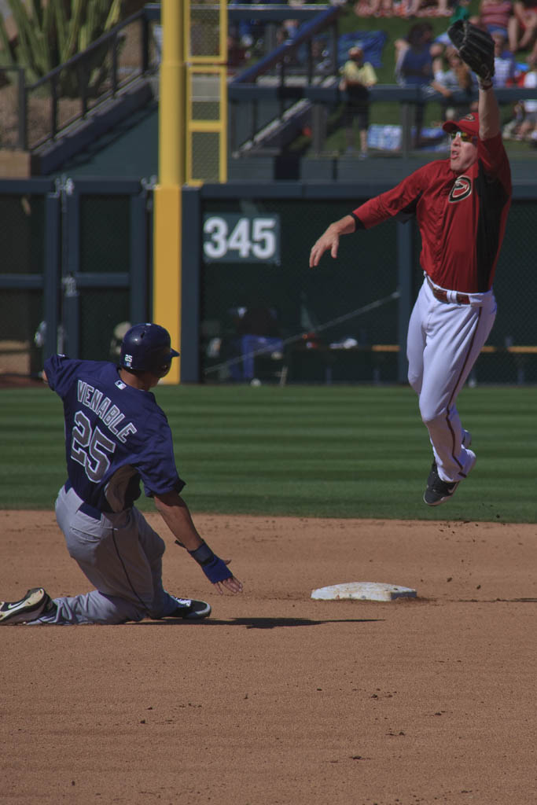
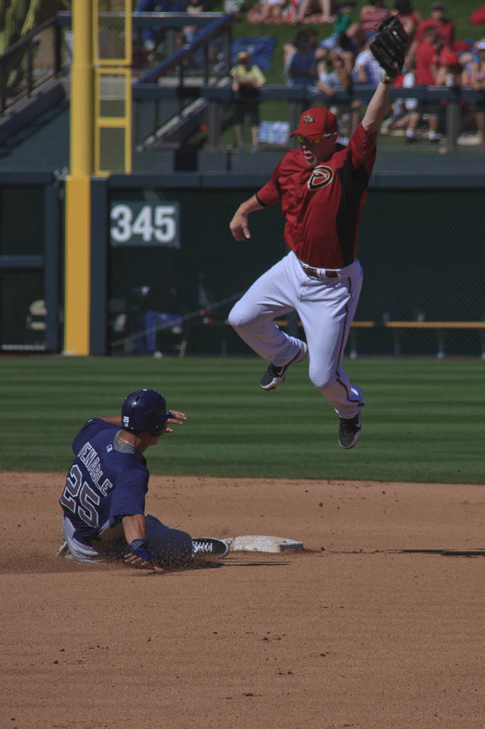
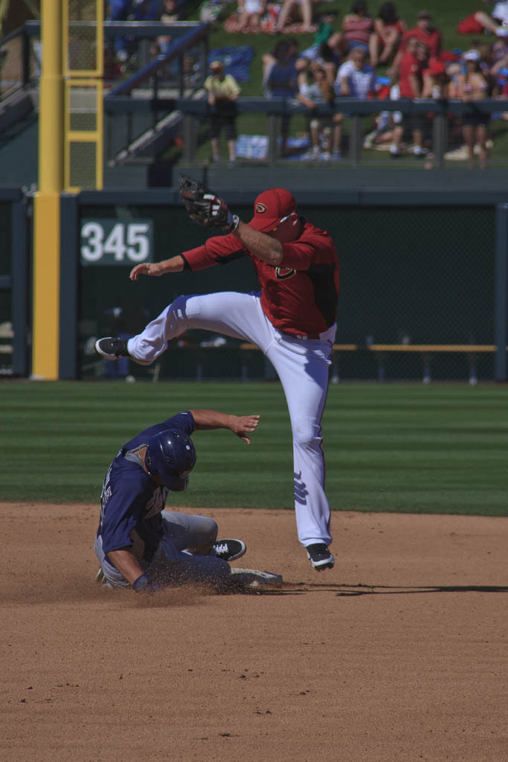
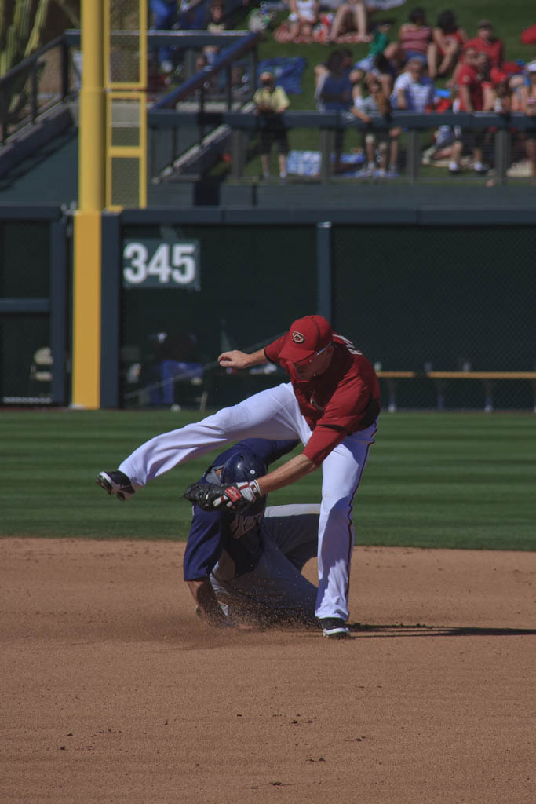
Continuous Shooting
< 1 sec.

Slide 10
Ideas on Technique
Use a mono-pod
Choose focal length to set frame size for capturing the action
Continuous shooting gives you choices
Test the light for speed before you start
Don’t overlook the basics of a good photo
Be sure to bring enough storage cards
Shoot in JPEG
Use a fast lens, f2.8 highly preferable
Include the players’ eyes and the ball
For more…http://photography.tutsplus.com/tutorials/8-tips-for-taking-sports-photos-like-a-pro--photo-296

