Slide 1
LENS QUALITY: MTF, RESOLUTION & CONTRAST

Slide 2
F8 and everything Auto
LENS QUALITY: MTF, RESOLUTION & CONTRAST

Slide 3
LENS QUALITY
RESOLUTION & CONTRAST,
MTF Charts
Bokeh
LENS QUALITY: MTF, RESOLUTION & CONTRAST
Notes:
The resolution of digital photos is limited by the camera's lens not by the resolution of the camera itself.
What's important when purchasing photographic equipment?

Slide 4
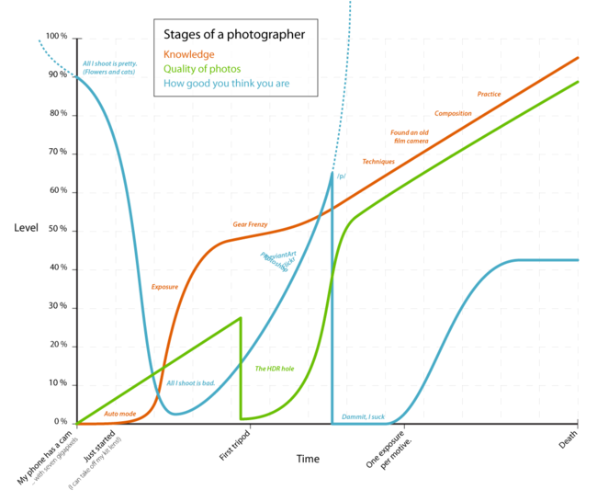

Slide 5
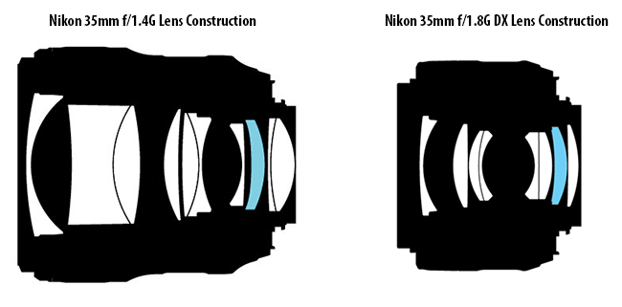
LENS QUALITY: MTF, RESOLUTION & CONTRAST
Notes:
What happens to an image when it passes through a camera lens and is recorded at the camera's sensor.

Slide 6
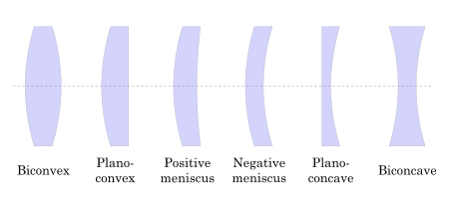
LENS QUALITY: MTF, RESOLUTION & CONTRAST

Slide 7
LENS QUALITY: MTF, RESOLUTION & CONTRAST

Slide 8
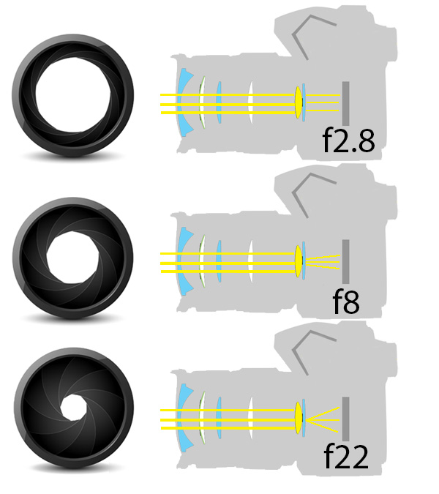
LENS QUALITY: MTF, RESOLUTION & CONTRAST

Slide 9
LENS
RESOLUTION & CONTRAST
LENS QUALITY: MTF, RESOLUTION & CONTRAST

Slide 10
What is blurry?
LENS QUALITY: MTF, RESOLUTION & CONTRAST

Slide 11
Unacceptable
Reasonably sharp
Sharp
LENS QUALITY: MTF, RESOLUTION & CONTRAST

Slide 12
LENS QUALITY: MTF, RESOLUTION & CONTRAST
Notes:
What is resolution
What is contrast and acuity

Slide 13
LENS QUALITY: MTF, RESOLUTION & CONTRAST
Notes:
The resolution of your lens, Contrast and edge clarity drops off as the lines become finer.

Slide 14
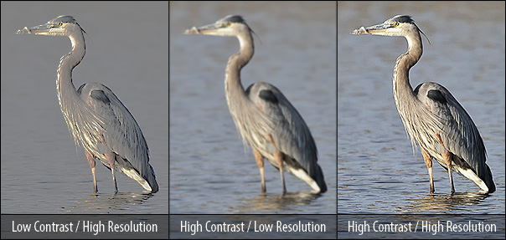
LENS QUALITY: MTF, RESOLUTION & CONTRAST

Slide 15
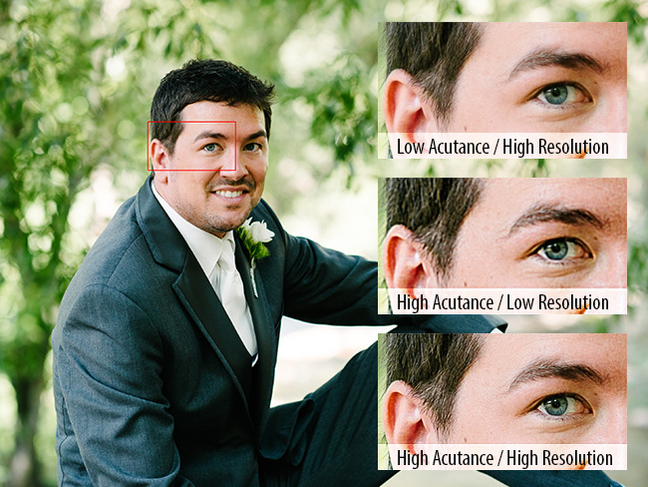
LENS QUALITY: MTF, RESOLUTION & CONTRAST

Slide 16
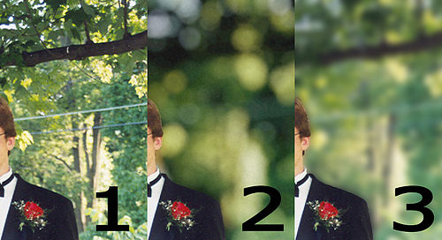
LENS QUALITY: MTF, RESOLUTION & CONTRAST

Slide 17
LENS QUALITY
LENS QUALITY: MTF, RESOLUTION & CONTRAST

Slide 18
LENS QUALITY
For two lenses with the same resolution, the apparent quality of the image will be determined by how well each lens preserves contrast
In order to make a fair comparison between lenses we need to establish a way to quantify this loss in image quality...
LENS QUALITY: MTF, RESOLUTION & CONTRAST

Slide 19
LENS QUALITY
Sources of poor quality
LENS QUALITY: MTF, RESOLUTION & CONTRAST

Slide 20
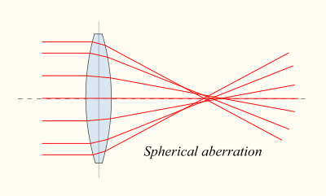
Loss of Image Quality
LENS QUALITY: MTF, RESOLUTION & CONTRAST

Slide 21
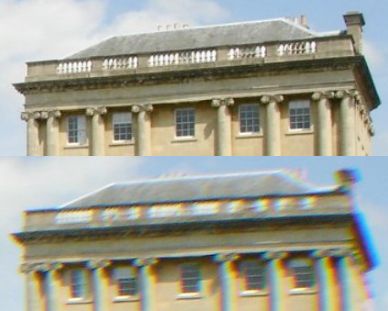
LENS QUALITY: MTF, RESOLUTION & CONTRAST

Slide 22
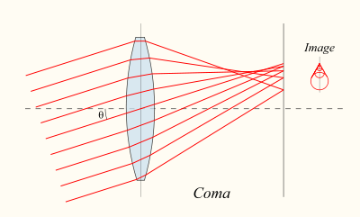
Loss of Image Quality
F8 and everything Auto
LENS QUALITY: MTF, RESOLUTION & CONTRAST

Slide 23
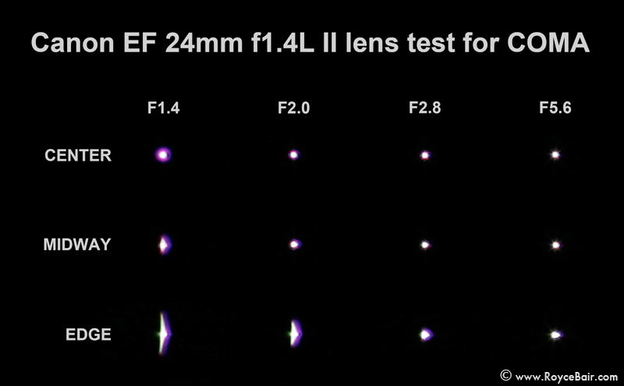
LENS QUALITY: MTF, RESOLUTION & CONTRAST

Slide 24
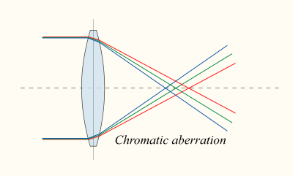
Loss of Image Quality
F8 and everything Auto
LENS QUALITY: MTF, RESOLUTION & CONTRAST

Slide 25
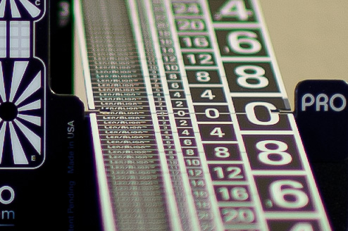
LENS QUALITY: MTF, RESOLUTION & CONTRAST

Slide 26
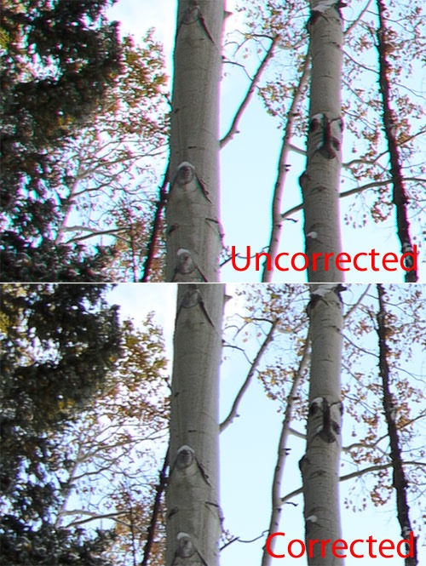
LENS QUALITY: MTF, RESOLUTION & CONTRAST

Slide 27
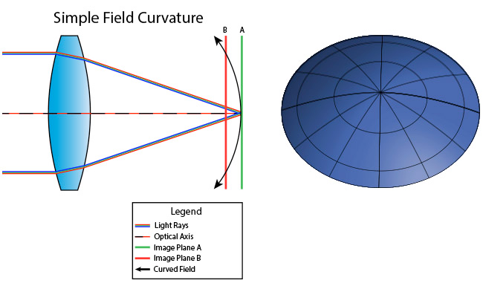
Loss of Image Quality
F8 and everything Auto
LENS QUALITY: MTF, RESOLUTION & CONTRAST

Slide 28
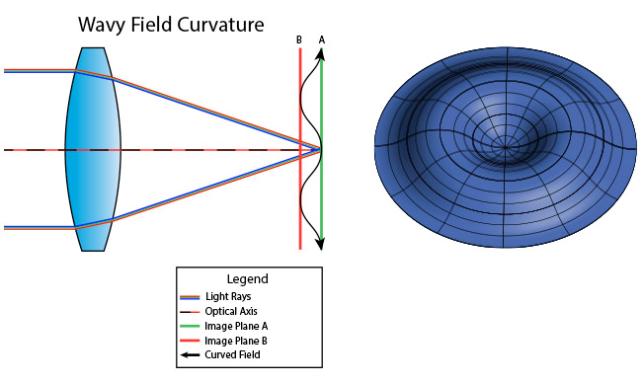
Loss of Image Quality
Real Lens
LENS QUALITY: MTF, RESOLUTION & CONTRAST

Slide 29
LENS
MTF Charts
Modulation Transfer Function
LENS QUALITY: MTF, RESOLUTION & CONTRAST

Slide 30
A Modulation Transfer Function (MTF) quantifies how well a subject's regional brightness variations are preserved when they pass through a camera lens.
*A perfect lens is one whose detail is limited only by diffraction.
See tutorial on diffraction in photography for a background on this topic.
LENS QUALITY: MTF, RESOLUTION & CONTRAST

Slide 31
MTF charts can provide
1. Lens Resolution (center to corners at maximum and stopped down apertures)
2. Lens Contrast (center to corners at maximum and stopped down apertures)
3. Astigmatism and Lateral Chromatic Aberration
4. Field Curvature
5. Focus Shift
LENS QUALITY: MTF, RESOLUTION & CONTRAST

Slide 32
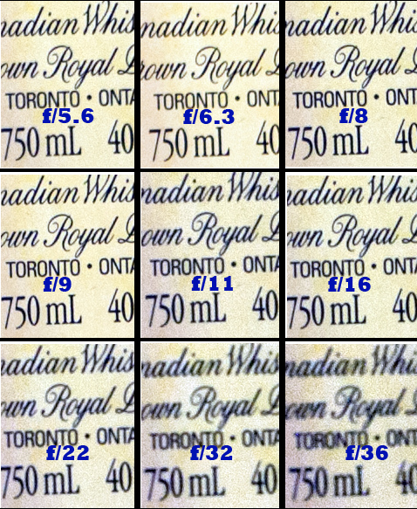
LENS QUALITY: MTF, RESOLUTION & CONTRAST

Slide 33
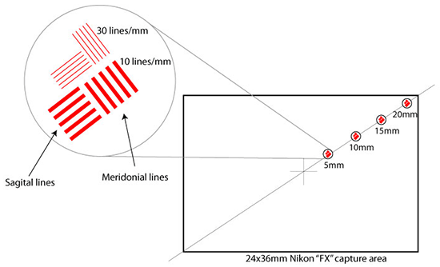
More Scientific Approach
LENS QUALITY: MTF, RESOLUTION & CONTRAST

Slide 34
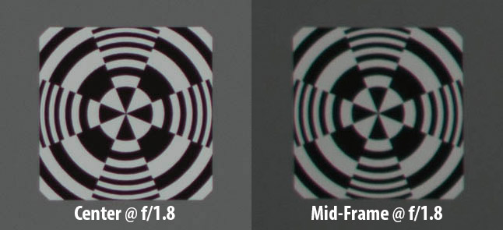
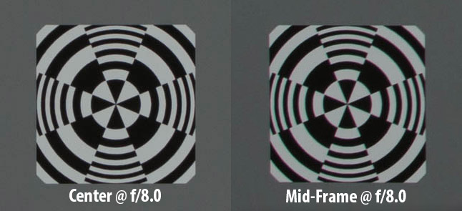
LENS QUALITY: MTF, RESOLUTION & CONTRAST

Slide 35
LENS QUALITY: MTF, RESOLUTION & CONTRAST
Notes:
What happens to an image when it passes through a camera lens and is recorded at the camera's sensor.

Slide 36
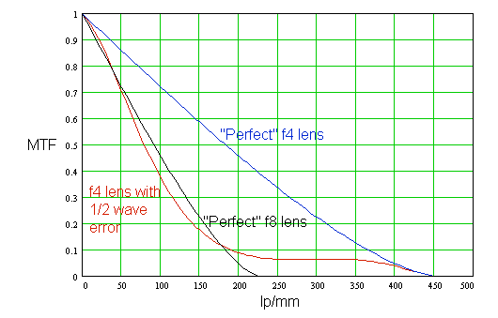
MTF curve for a perfect Lens
A perfect lens is one whose detail is limited only by diffraction.
Perfectly Scientific Approach?
LENS QUALITY: MTF, RESOLUTION & CONTRAST

Slide 37
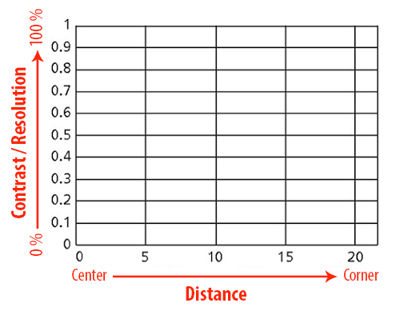
More Real Approach
LENS QUALITY: MTF, RESOLUTION & CONTRAST

Slide 38
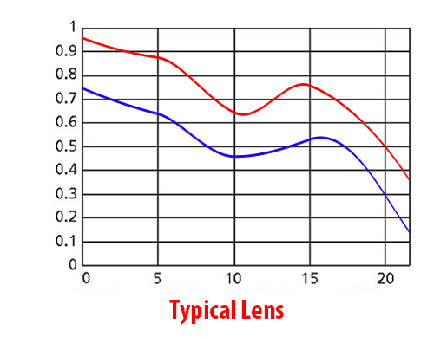
More Real Approach
LENS QUALITY: MTF, RESOLUTION & CONTRAST

Slide 39
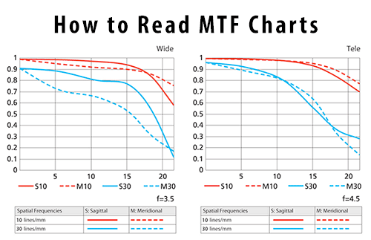
More Real Approach
LENS QUALITY: MTF, RESOLUTION & CONTRAST

Slide 40
More Scientific Approach
LENS QUALITY: MTF, RESOLUTION & CONTRAST

Slide 41
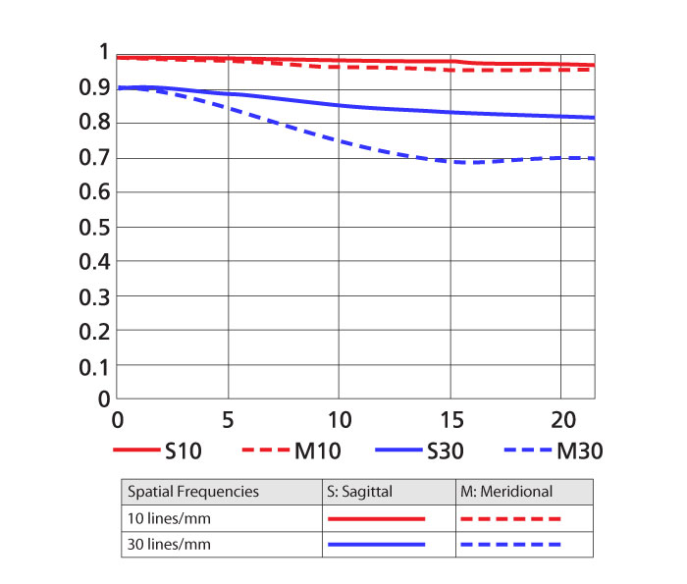
LENS QUALITY: MTF, RESOLUTION & CONTRAST

Slide 42
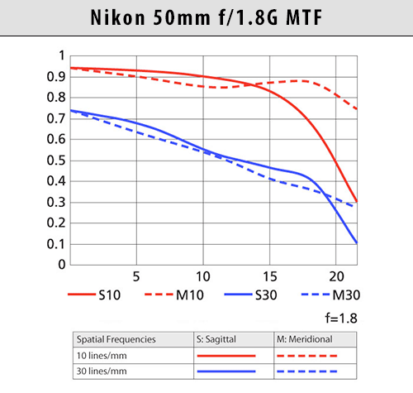
LENS QUALITY: MTF, RESOLUTION & CONTRAST

Slide 43
How to read Nikon MTF Charts
Nikon has been providing MTF data for every new lens it makes for a while now. You might not be able to find MTF charts for some of the very old Nikkor lenses, but all current ones have MTF data, including some 10-15 year old AF-D lenses. When it comes to providing lens performance data, Nikon’s MTF charts contain the following data:
Lens performance at the maximum aperture
Lens performance at the shortest and longest focal lengths
Sagittal and Meridonial Contrast and Resolution figures at 10 lines/mm and 30 lines/mm
Astigmatism and Lateral Chromatic Aberration
Field Curvature
LENS QUALITY: MTF, RESOLUTION & CONTRAST
Notes:
No stopped down performance of lenses at f/8 (like Canon and other manufacturers do).
MTF data is also limited for zoom lenses, only the shortest and the longest focal lengths are provided.
In the case of superzoom lenses like Nikon 18-300mm, it basically means that you can only look at the performance at 18mm and 300mm, but nothing in between.

Slide 44
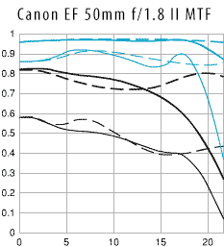
LENS QUALITY: MTF, RESOLUTION & CONTRAST

Slide 45
How to read Canon MTF Charts
Canon also shows the stopped down performance of lenses at f/8, which can be very useful.
Lens performance at the maximum aperture and f/8
Lens performance at the shortest and longest focal lengths
Sagittal and Meridonial Contrast and Resolution figures at 10 lines/mm and 30 lines/mm
Astigmatism and Lateral Chromatic Aberration
Field Curvature
Focus Shift
LENS QUALITY: MTF, RESOLUTION & CONTRAST

Slide 46
LENS Bokeh
Bokeh has been defined as "the way the lens renders out-of-focus points of light
LENS QUALITY: MTF, RESOLUTION & CONTRAST

Slide 47
LENS QUALITY: MTF, RESOLUTION & CONTRAST

Slide 48
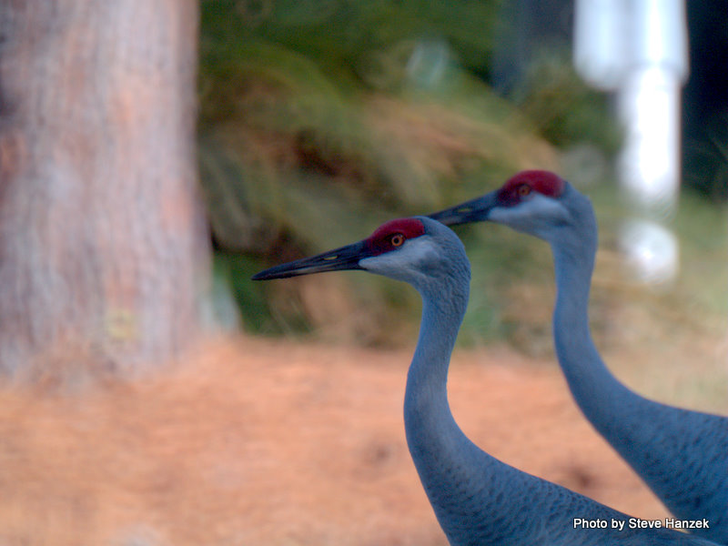
LENS QUALITY: MTF, RESOLUTION & CONTRAST

Slide 49
LENS QUALITY: MTF, RESOLUTION & CONTRAST

Slide 50
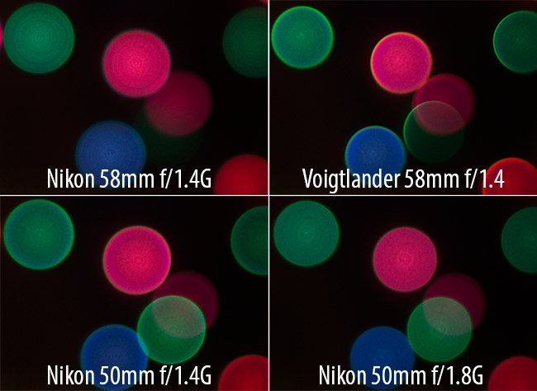
LENS QUALITY: MTF, RESOLUTION & CONTRAST

Slide 51
http://www.luminous-landscape.com
https://photographylife.com/what-is-focus-shift
http://www.kenrockwell.com/tech/mtf.htm
http://www.cambridgeincolour.com/
LENS QUALITY: MTF, RESOLUTION & CONTRAST

Slide 52
LENS QUALITY: MTF, RESOLUTION & CONTRAST

